Slide 1
XZAM
Marco Campos
Shah Newaz
Christopher Simon

Slide 2
Table of Contents
Problem Statement…………………………………………………………………………………………………………………………….1
Proposed Solution and Goals.………………………………………………………………………………………………………………...2
Functional and Nonfunctional Requirements………………………………………………………………………………………………...3
System Diagram..……………………………………………………………………………………………………………………………...4
Requirement Specification & Use­ Case Diagrams.…………………………………………………………………………………………...5
Sequence Diagrams...…………………………………………………………………………………………………………………………6
Class Diagrams and Interface Specification.…………………………………………………………………………………………………7
Traceability Matrix (Use Cases vs Requirements) …………………………………………………………………………………………..8
Methodology Usage ………………………………………………………………………………………………………………………….9
Implementation Details and UI.……………………………………………………………………………………………………………..10
History of Work.…………………………………………………………………………………………………………………………...…11
Current Status ……………………………………………………………………………………………………………………………..…12
Future Steps and Extensions.…………………………………………………………………………………………………………...……13
Lessons Learned.…………………………………………………………………………………………………………………………..…14
Benefits of CSC 131.…………………………………………………………………………………………………………………………15

Slide 3
Problem Statement
For the past few years, an increasing number of students have had the goal of acquiring a position in the medical field. Requiring copious amounts of memorization of numerous medical terminologies and key words, studying for such a career can be a daunting process. Conventional methods of note taking and reading can become mundane to students who study over long periods of time. As a result, students who study in this repetitive manner will eventually retain less information over time.
Presented By: Marco Campos

Slide 4
Proposed Solution and Goals
With the goal of improving memorization skills through interactive, enjoyable learning, our team will be developing an application to aid in student studying, particularly for those students who are perusing a medical degree. Students who utilize the app will be able to choose from various categories of which they are currently reviewing or studying for. With the plan of developing a practice test generator for each category, students will choose the amount of questions that they desire being tested on. As our primary goal is to improve retention, test questions will be asked at random, and users will be able to select questions that they no longer want to be tested on anymore. When a run of the practice test has been completed, users will have the option of retaking the same exam with the same set of questions, or only going over the questions that they had trouble with. Users will have the ability to exit out of a test at any given time.
As none of our team members are medical students, surveying, and information research using viable online resources and textbooks, will be done in order to collect the data necessary for our application. Our information will be stored and retrieved from a database, and the application will make requests to pull data from it. Students also have the ability of reporting questions that they believe to be incorrect, so that an administrator can update the information accordingly.
Presented By: Marco Campos

Slide 5
System Diagram
The system diagram represents the flow of events within the application, according to the user’s perspective. A user, when interacting with the application will first be shown the view, which contains the interface for the user to interact with. Users interact with the application using the GUI which is bound to the controller, which delegates actions between the model and the view. After the controller sends the user action to the model, the model sends the response back to the view through the controller. In this case, the model is separate from the actual application, as it is a database.
Presented By: Christopher Simon

Slide 6
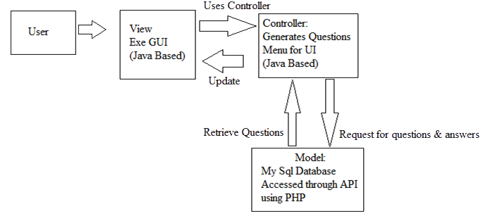
System Diagram
Presented By: Christopher Simon

Slide 7
Completed Functional Requirements
Requirement | Description
Termination | The user should have the ability to terminate the application at any time.
Choose from subcategories | The user should be able to choose the topic that they desire to be tested on. Once the topic is chosen, questions generated for that test must only come from that specified topic.
Choose number of questions | After selecting a subcategory, the user should be able to set the number of questions to be included on the practice test.
Scores List | At end of each test, the application will provide the number of correct answers over the number of total selected questions for that test.
Random Question Generator | The application will generate a random set of questions that will eventually be retrieved from the database when a read request is made.
Presented By: Shah Newaz

Slide 8
Functional Requirements
Requirement | Description
Authentication via API | Users and Administrators must be authenticated before being able to access the API that makes requests to the database on the user’s behalf. This prevents users from modifying the database directly.
Review Previous Incorrect Questions or Whole Test | After taking a test, the user should have the option of retaking the same test, with the option of retaking only the incorrect questions again or the whole test again.
Read Question | After generating a list of questions to select for the test, the application will obtain the selected questions from the database through the API, so that they can be displayed to the customer one at a time.
Create Question | The Admin will create new questions for the database through the API.
Presented By: Shah Newaz

Slide 9
Functional Requirements (cont)
Requirement | Description
Create Question | The Admin will create new questions for the database through the API.
Update Question | The Admin will update the database with advised questions, provided from the users.
Delete Question | The Admin will delete existing questions from the database through the API.
Request to revise Question | The user will be able to submit a request for revisal of a question if he/she believes that it yields false information.
Apply updates to Application | The admin will modify the application in order to fix bugs and to add features.
Presented By: Shah Newaz

Slide 10
Nonfunctional Requirements
Requirement | Description
Graphical User Interface (GUI) | The application will be visually pleasing, using textboxes, pictures, and buttons when applicable. The application must be fluid and responsive.
Navigation | The user will be able to navigate to whatever they need in a timely manner that does not disrupt workflow or slow down the user.
Interaction | Test taking will be constructed in such a way that allows for the user to review certain questions or content within a specific subcategory whenever they desire, while in the selected subcategory.
Presented By: Shah Newaz

Slide 11
Use Case Diagram
The use case diagram demonstrates the whole processes of the actor and the admin interacting with the Software Application System and Database respectively. After authenticating, the admin has access to the database through the API, which allows him/her to create, update, and delete content in the database. The user, after navigating through the Application System and selecting a subcategory, will be presented with a set of questions retrieved from the database through the API. For users, extends features consist of making requests to revise questions, reviewing the previous question answered incorrectly after taking an exam, and viewing their score after an exam.
Presented By: Christopher Simon

Slide 12
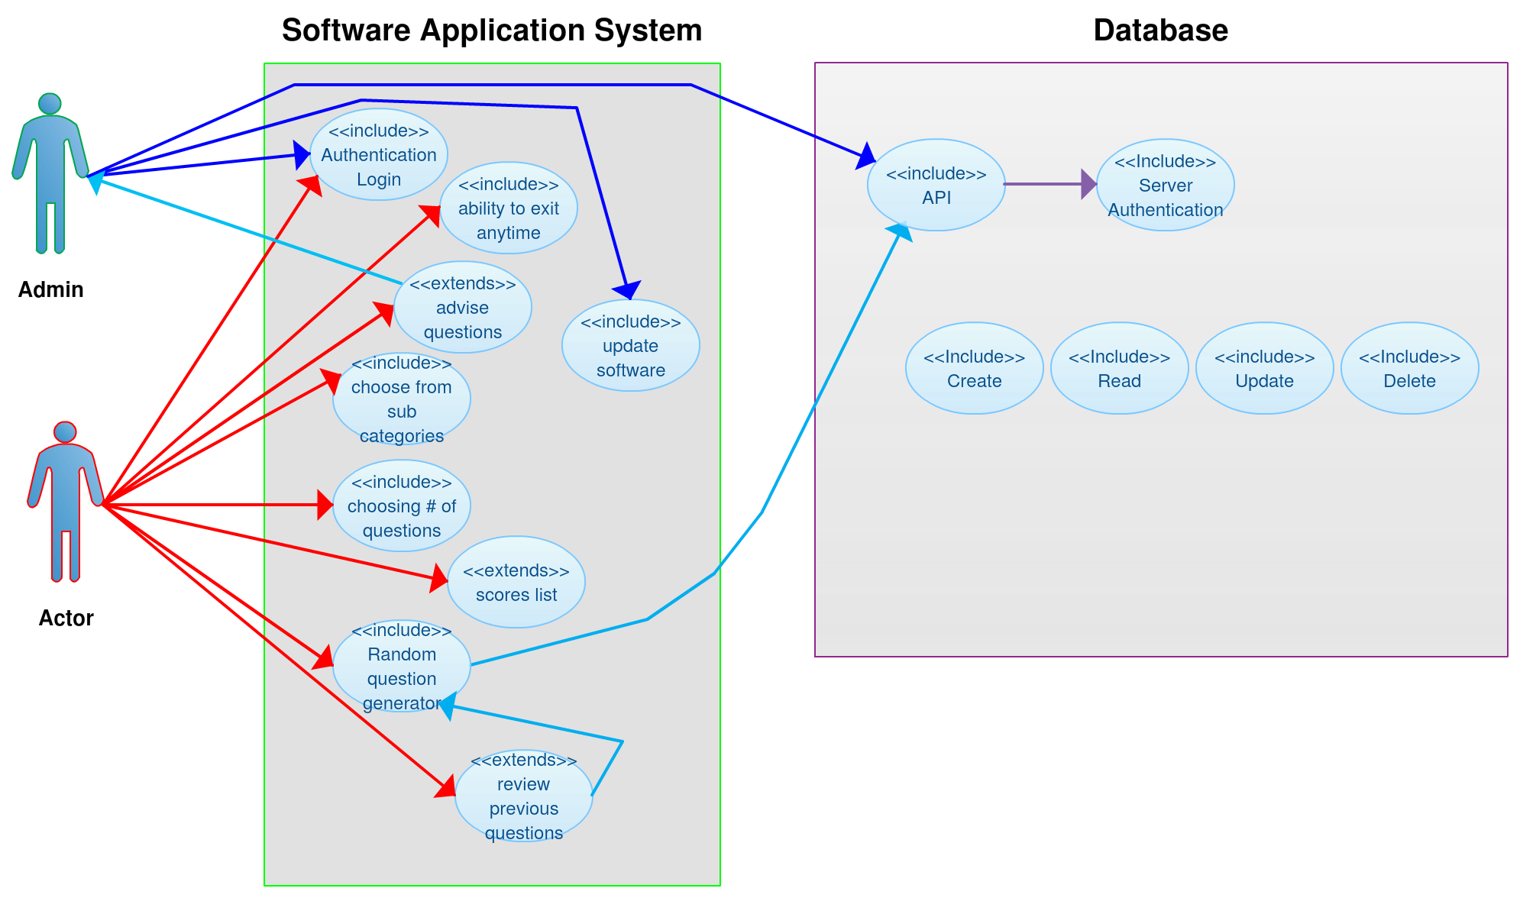
Presented By: Christopher Simon

Slide 13
Use Cases
Use Case # | User Case Description | Use Case Details
1 | User chooses one of the Systems | Use Case Name: System Actors: User Priority: High Status: Initial Development Pre-Condition: Authenticated Post-Condition: Current system is selected. Access to Subcategories. Extension Points: N/A “Used” Use Cases: Subcategory
2. | User chooses a Subcategory: Medical Terminology Multiple Choice Definitions Test | Use Case Name: Subcategory Actors: User Priority: High Status: Initial Development Pre-Condition: User must have selected a system. Post-Condition: The subcategory is selected. Selected subcategory options are displayed. Extension Points: N/A “Used” Use Cases: Subcategory
Presented By: Christopher Simon

Slide 14
Use Cases (cont)
Use Case # | User Case Description | Use Case Details
3 | Subcategory options : User will take a practice test, deciding how many questions they desire being tested on. When user answers an answer correctly, they earn a point. When user answers an answer incorrectly no point will be given and answer will be optionally displayed. The user may quit the test at any time. The user has the option to move to the previous menu at any time. | Use Case Name: Subcategory options Actors: User Priority: High Status: Initial Development Pre-Condition: User must have selected a subcategory Post-Condition: User is prompted for the number of questions. Extension Points: Taking the test. “Used” Use Cases: N/A
4 | Test: User takes the test | Use Case Name: Taking Test Actors: User Priority: High Status: Initial Development Pre-Condition: User must have selected to take a test. User has selected the # of questions on the test. Post-Condition: User finishes the test. Extension Points: termination of application “Used” Use Cases: N/A
Presented By: Christopher Simon

Slide 15
Use Cases (cont)
Use Case # | User Case Description | Use Case Details
5 | Incorrect answers: User may review all the incorrect answers from each subcategory | Use Case Name: Reviewing Actors: User Priority: Medium Status: Initial Development Pre-Condition: User must have taken a test. User must have incorrect answers. Post-Condition: User will have gone over all the incorrect answers. Extension Points: N/A “Used” Use Cases: Taking the test
6 | Requesting new questions: User suggests new questions to the Admin | Use Case Name: Advise questions Actors: User Priority: low Status: Initial Development Pre-Condition: User must be Authenticated Post-Condition: Admin will have new questions to input to the database Extension Points: N/A “Used” Use Cases: N/A
Presented By: Christopher Simon

Slide 16
Traceability Matrix
Requirement | Use Case Actor | Use Case Admin | Use Case Database
Log in | Access to software | Access to Software and database | Authentication API
Navigation | Ability to move to next page | Ability to move to next page | N/A
Subcategories | Choosing category | N/A | The database organizes in a way that the questions will only be accessed by the category the actor chooses
Choose the Amount of Questions | Actor choose the amount of questions that will be asked | N/A | N/A
Correct Answer Display | After every wrong answer the correct answer will display | N/A | The database will include the answer only if the actor gets the answer incorrect
Random Question Generator | N/A | N/A | Generates the questions that will be asked
Score List | display the correct answers | N/A | Store the number of correct answers
Ability to Terminate | Actor can quit at any time during test | N/A | N/A
Incorrect Answers Review | Actor will have the ability to review the incorrect answers | N/A | The database will recognize the incorrect answers and store them for later use.
Update Questions | N/A | Admin will have the ability to update new questions and delete questions from database | The database will be updated for ambiguous questions, or needed questions
Read | The questions will be displayed to the actor | N/A | Generated Questions to be read by the actor
Create | N/A | Admin creates | The ability to add additional questions
Update Software | N/A | Admin will update in the database | N/A
Advise Questions | Actor will advise questions to the admin | If advised questions are valid, questions will be added to database | N/A
Presented By: Christopher Simon

Slide 17
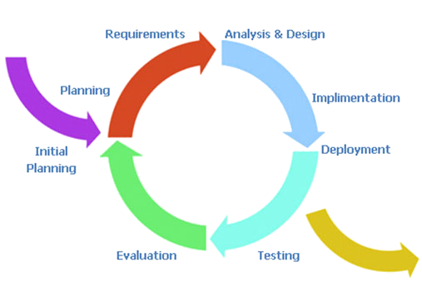
Methodology Usage
Our project will resemble the incremental modeling process.
Initially we discussed the effectiveness of the agile process
Decided against it because it’s our first time creating a project through repetitive documentation
Decided that incremental model might be more beneficial for a steady and controlled development process
Presented By: Shah Newaz

Slide 18
Sequence Diagram
The sequence diagram displays the interactions between the user, software and the database. As you can see that the user interactions are displayed on the left hand side of the diagram, while the interactions with the software and the database interactions are displayed on the right. Here is a step by step sequence diagram which shows how the interactions will work.
This diagram will illustrate how the user will interact with the program and how the program will interact with the database. Not only does it show the user will interact with the program, but also it shows the steps of how 1 scenario of many will occur during log in.
Presented By: Shah Newaz

Slide 19
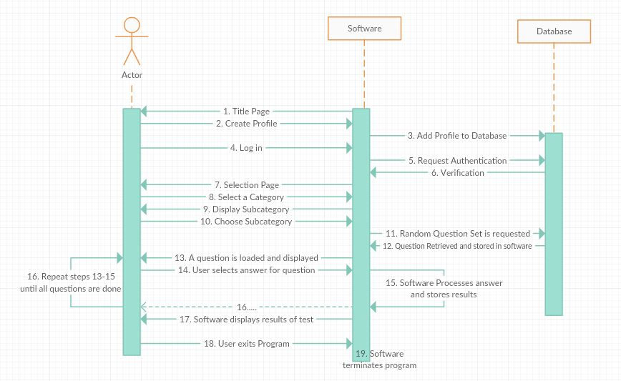
Sequence Diagram
Presented By: Shah Newaz

Slide 20
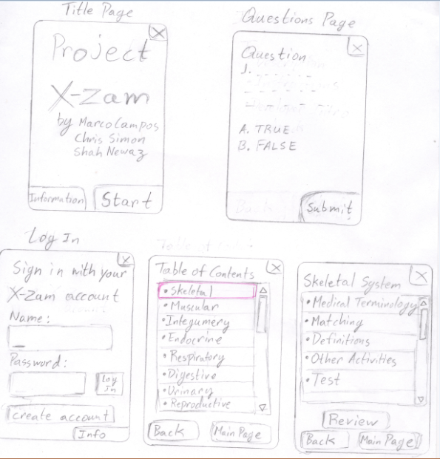
UI Prototypes
Presented By: Shah Newaz

Slide 21
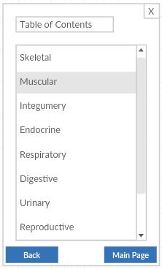
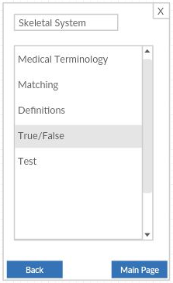
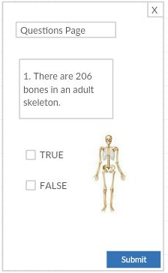
UI Prototypes
The user will be able to choose a variety of systems.
The user then chooses what types of questions he or she wants to be asked.
Finally this displays how a certain question will be asked.
Presented By: Shah Newaz

Slide 22
Activity Diagram
Basic display of how the user will interact with the program
The arrows on each line describes the bidirectional traversal path
Presented By: Shah Newaz

Slide 23
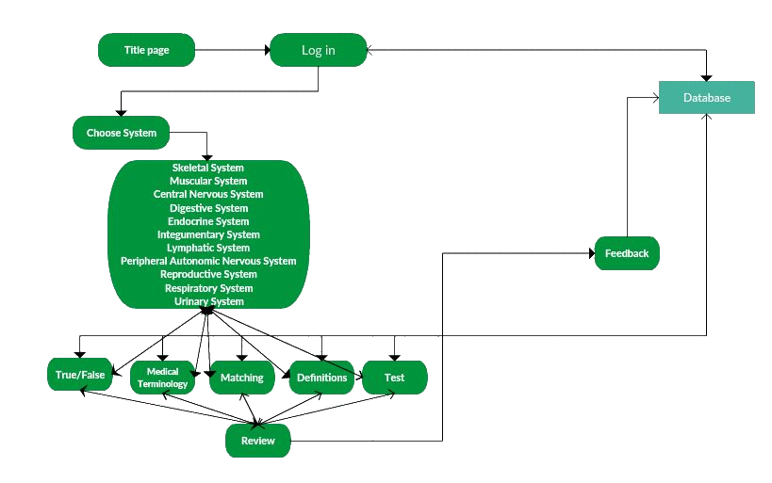
Activity Diagram
Presented By: Shah Newaz

Slide 24
Class Diagram
Each box represents a class
Aggregation, is represented with the hollow diamonds. Each class that shares a collection of classes.
Composition, is represented with the filled diamonds. These filled in diamonds mean that the class is not shared with more than one class.
Classes that contain aggregation:
Login
Question
QuestionReview
GUI
Database
Classes that contain composition:
Main
Category
Test
Presented By: Marco Campos

Slide 25
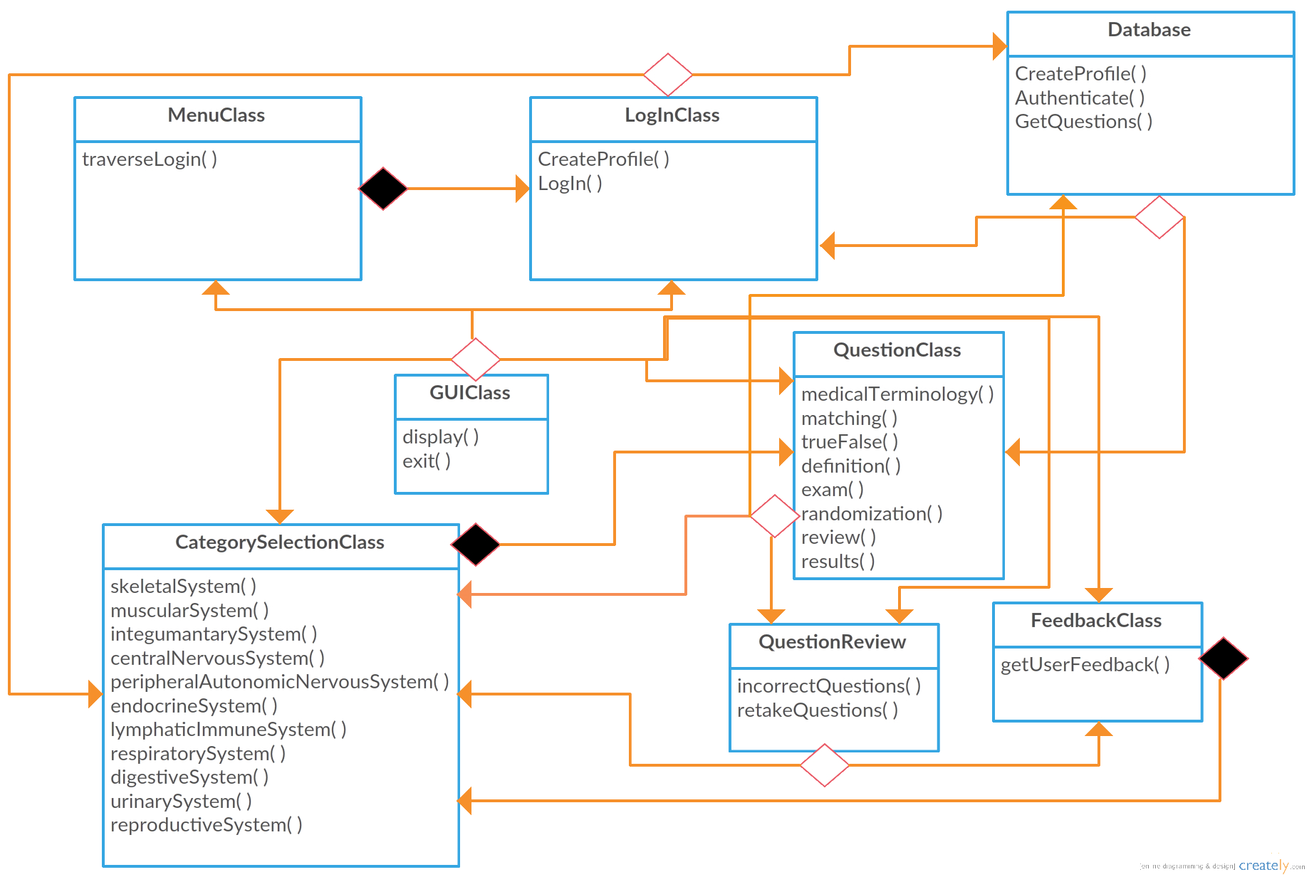
Class Diagram
Presented By: Marco Campos

Slide 26
Entity Relationship Diagram
Describes the structure of the data stored in the database
The data is broken up into categories that have many questions which have many choices.
Connected table data is associated through join tables, which are composed up of the different table ids.
Presented By: Christopher Simon

Slide 27
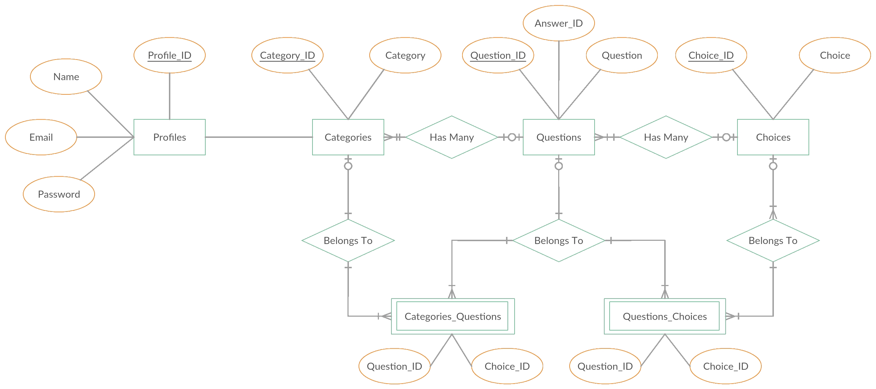
Entity Relationship Diagram
Presented By: Christopher Simon

Slide 28
Data Flow Diagram
Illustrates how data objects flow within the program and how state is transformed
Squares represent entities that the external entity
Circles will represent the process
The Arrows will represent the data flow process
The double parallel lines represents the data store.
The database is what stores all the user information.
Presented By: Christopher Simon

Slide 29
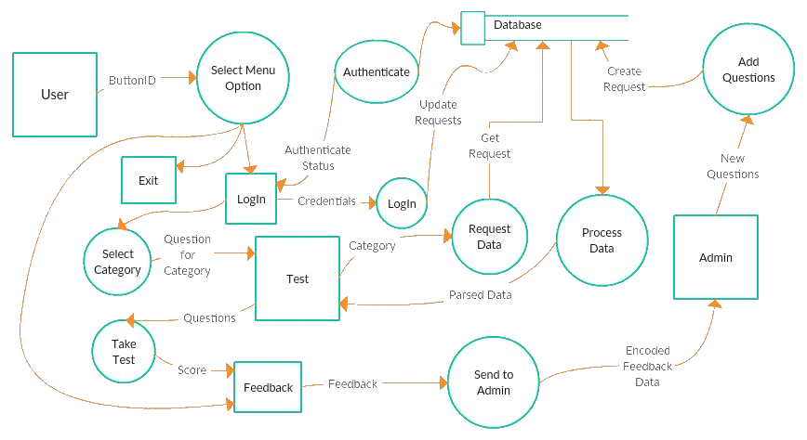
Data Flow Diagram
Presented By: Christopher Simon

Slide 30
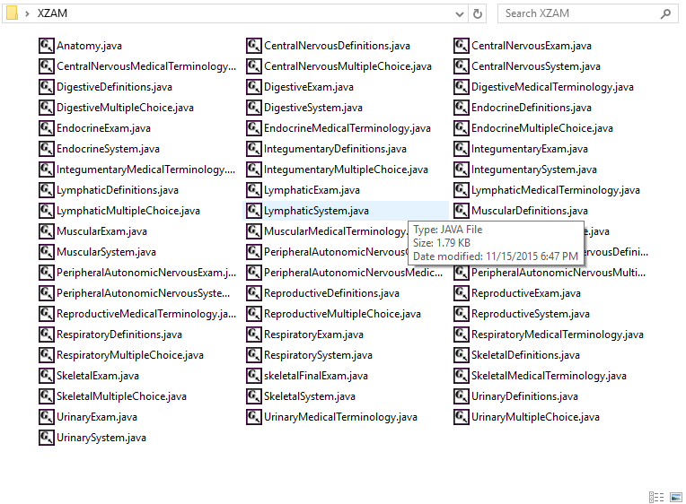
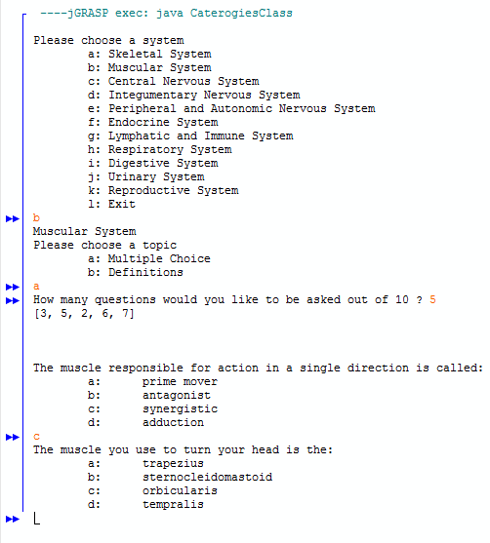
History of Work
Original: 58 Separate java classes files
Current: Questions loaded from txt file
Presented By: Marco Campos

Slide 31
Current Status
Category selection
The user is able to select which system he or she wants.
Sub category selection
Multiple choice
Definitions
True or false
Medical terminology
Test (which is a combination of the 4 above choices
Questions class
The questions are randomly generated from the database. If a certain topic has 50 questions, he or she may choose a number from 1-50 questions he or she wants to be asked. If a question has been asked, then that question will not be asked again.
A point will be given for every correct answer.
For each incorrect answer, it will be stored to the database and will be available for the user to be asked for review purposes.
Presented By: Marco Campos

Slide 32



Future Status
Finishing up functional requirements, followed by nonfunctional requirements. Mostly database integration:
Authentication via API
Review previous incorrect questions or whole test
Read question
Create question
Update question
Delete question
Request to revise question
GitHub integration
Easier to manage code compared to Google drive.
Follows iterative design model
BlueJ
Switch to BlueJ IDE for use of automatic UML Generator
Presented By: Christopher Simon

Slide 33
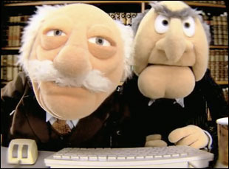
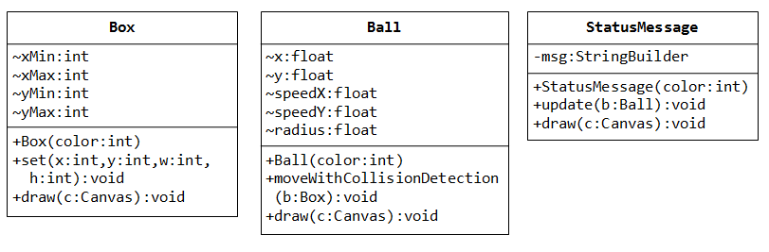
Lessons Learned
Refactoring
Class Diagram Usage
Pair Programming
Entity Relationship Diagram

Slide 34
Benefits CSC 131
Because of CSC 131 class we were able to learn how to document the software engineering process.
Had we not taken this course, we would have just done some coding and it would have been difficult to make any changes to the software over time. This would have made us lost with the possibility of losing valuable time and money.
Most people in the industry use these se process so that it becomes safer and cost effective and it’s good to be familiarized with them
Therefore for future projects, we can look back to this experience, apply similar techniques and make projects that are easier to document and create.

